Slide 1
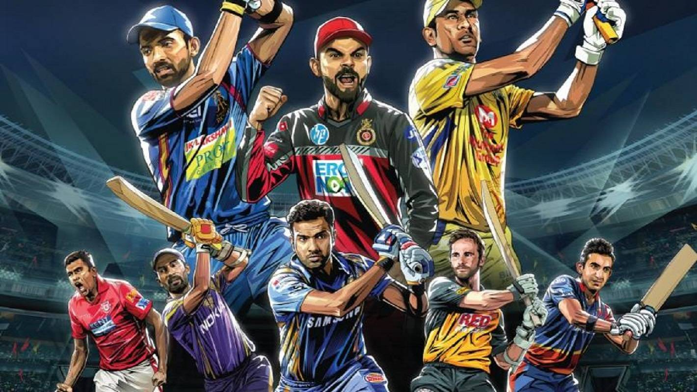

Exploratory Data Analysis -Indian Premier League Match
by Sruthi S Kumar

Slide 2

IPL History
Indian Premier League (IPL) is a professional Twenty Twenty Cricket league in India contested during March or April and May of every year, founded by Board of Control for Cricket in India (BCCI).
Teams representing each states in India – each playing twice home and away round robin format.

Slide 3
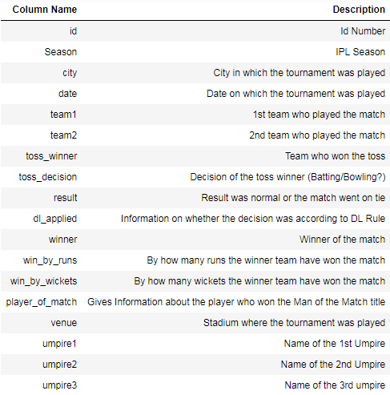
About the Data
10 IPL seasons Data
693 Observation , 14 columns
Information on Season, city, data,
Teams, toss winner, toss decision,
Result, winners etc

Slide 4
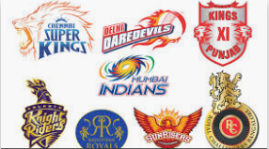
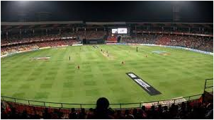
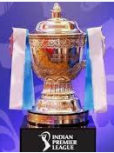
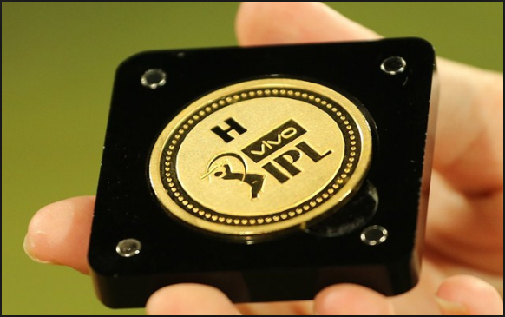

Problem Statement
Venue?
Teams ?
Bad Weather?
Toss Decision ?

Slide 5

Pre-Processing :
Removed ‘City’ columns as it had missing values and ‘Venue’ can give better insight.
Umpire Details removed
Data that contains empty values in ‘result’ column and those match details which went on a tie has been removed.
Duplicate Data was removed.

Slide 6
Questions :
Matches during 10 IPL Seasons
Best teams in each IPL Seasons
Worst performing teams in each IPL Seasons
Most Valuable Players in IPL
Does toss decision have any role in deciding the winner of the match
Which is the dangerous bowling team to play with?
Which is the most dangerous batting team to play with?
Which is the overall BEST teams in IPL history?
What is the probability of winning if the opposing team is one among the best team?
Does Climate have any effect on the IPL match result?

Slide 7
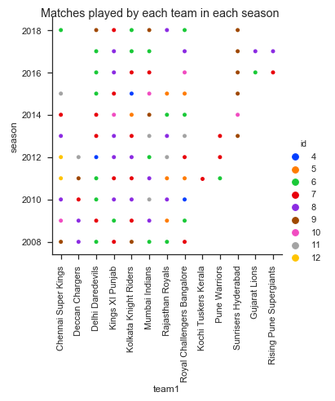
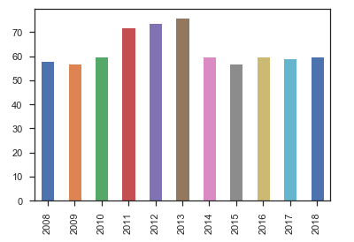
1. Matches during 10 IPL Seasons

Slide 8
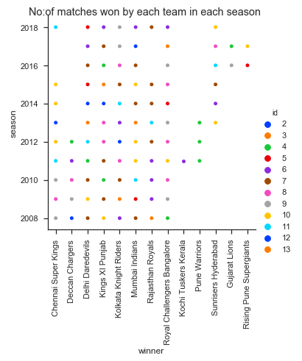
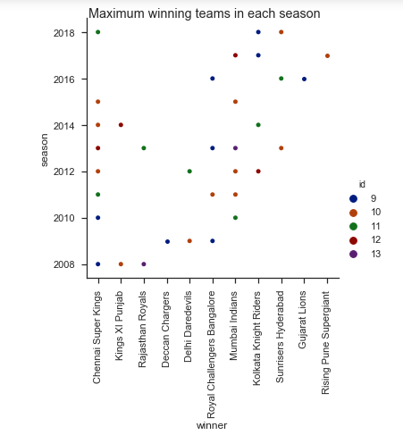
2. Best Teams in each IPL seasons

Slide 9
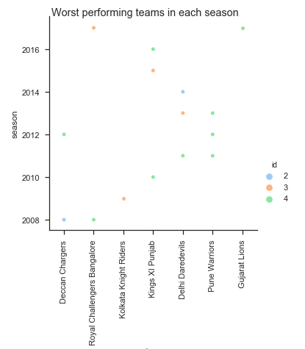





3. Worst Teams in each IPL seasons

Slide 10
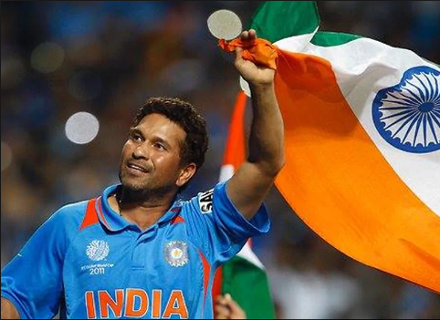
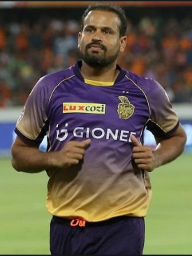
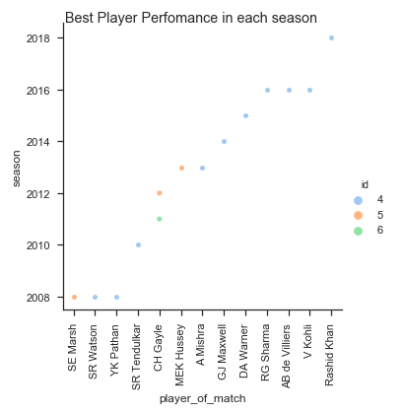
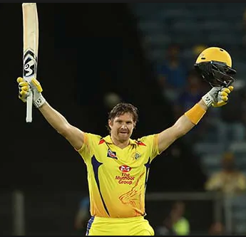
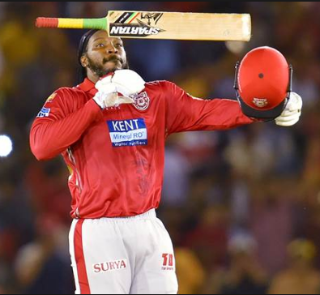
4. Most Valuable Players in IPL

Slide 11
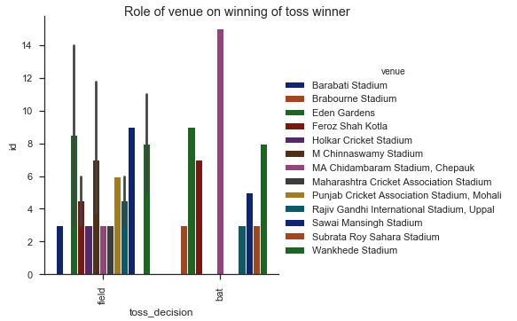
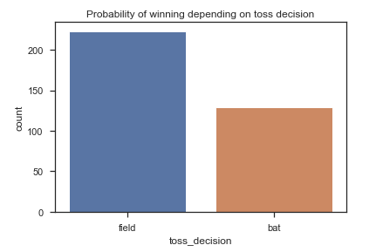
5. Does the toss decision have any role on deciding the winner of the match?
63.86%
36.13%

Slide 12

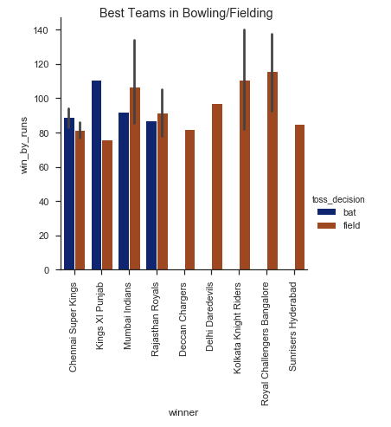






6. Which is the dangerous bowling teams to play with?

Slide 13
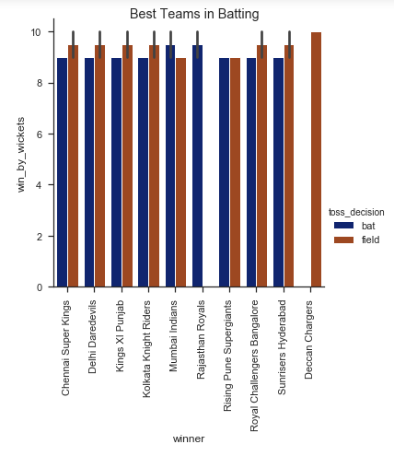

7. Which is the dangerous batting teams to play with?

Slide 14
8. Which is the overall BEST teams in the history of IPL?

Slide 15

9. What is the probability of winning if the opposite team is one among the best teams?
Low as 3.2%

Slide 16
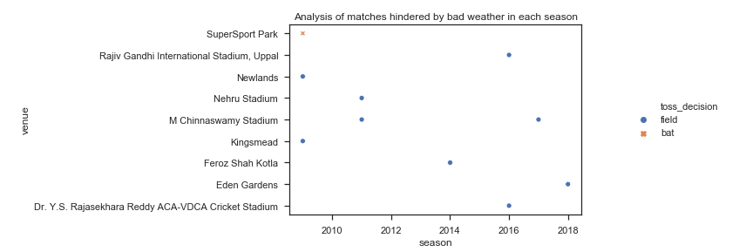
10. Does Climate have any effect on the match flow?
Overall in 10 seasons, 19 times DL rule were applied.
90% times, team who have decided to bowl have won the match.
In the year 2009, 3 times DL Rule was applied to calculate the target score due to bad weather.

Slide 17
Conclusion
Consistent Performance is the key to have a better future as a team in IPL.
Better Players → Better team. Thus starting from Auction, Owners or respective stakeholders should take best players into the team.
Toss Decision : Captain have a major role in deciding the winning the match. Deep Analysis of the venue, opposing team, players and climate add to a better toss decision.

